Slide 1


MODULE-7
JDBC
Java Database Connection

Slide 2
Course Topics
→ Module 1
» Introduction to Java
→ Module 8
» Servlets
→ Module 2
» Data Handling and Functions
→ Module 9
» JSP
→ Module 3
» Object Oriented Programming in Java
→ Module 10
» Hibernate
→ Module 4
» Packages and Multi-threading
→ Module 11
» Spring
→ Module 5
» Collections
→ Module 12
» Spring, Ajax and Design Patterns
→ Module 6
» XML
→ Module 13
» SOA
→ Module 7
» JDBC
→ Module 14
» Web Services and Project

Slide 3

Objectives
At the end of this module, you will be able to
→ Understand database
→ Understand RDBMS and its advantages
→ Execute SQL Queries
→ Create JDBC connection to the database
→ Perform CRUD operation on the database from your Java application
→ Perform Batch processing and Transaction management

Slide 4

John Meets Daisy..
Hi John…

Slide 5

John Meets Daisy..
Hi Daisy…

Slide 6

Daisy has a Doubt
I need a little help from you. I need to clarify some doubts..

Slide 7
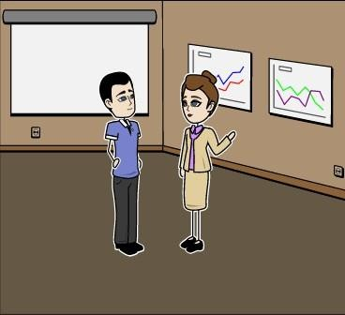
Daisy has a Doubt
Why do we need to store data in the text file when I can have it in the program?

Slide 8

Daisy explains the Concept..
We can store the data in text file permanently. If it is in a program then once the system is off, all the data is lost. The data in a program is volatile.

Slide 9

Daisy explains the Concept..
But is the data safe in a text file? Is it the best way to store it?

Slide 10

Daisy explains the Concept..
Not exactly. Text files have their own limitations. Anybody can modify the data in text file, it’s not secure. For this reason, we use databases to store data.

Slide 11
Limitations of a text File
→ A regular text file is not secured.
→ Concurrency is not provided.
→ There is no proper structure or guidelines when to create a new file or to add a new field in
the existing data file.
→ Anybody can modify/delete the data by just opening the file.
→ Everybody can maintain their own data file and the user may not update their copied data
file when the data is updated.
→ Multiple copies of the text file is maintained and the user may not be able to distinguish the file with relevant and complete data.

Slide 12


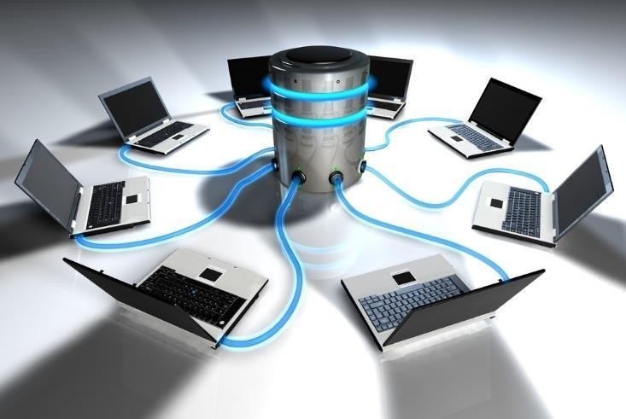



What is a Database?
Group of tables
→ A field is an information or attribute of an object.
→ Group of fields will form a record.
→ Group of records are in a table.
→ Group of tables are in a database or relational database or RDBMS.

Slide 13
Database - Example
Example: fields to students on fields, records, table and db.
Fields
Table
ID | NAME | AGE | ADDRESS | SALARY
ID | NAME | AGE | ADDRESS | SALARY
1 | John | 32 | California | 2000.00
2 | Jack | 25 | Arizona | 1500.00
3 | Nancy | 23 | Texas | 2000.00
4 | Linda | 25 | Washington | 6500.00
5 | Shane | 27 | New Mexico | 8500.00
6 | David | 22 | Georgia | 4500.00
7 | Mary | 24 | Florida | 10000.00
Record
1 | John | 32 | California | 2000.00
Column
ADDRESS
California
Arizona
Texas
Washington
New Mexico
Georgia
Florida
Database
A Database is a collection of tables

Slide 14
RDBMS

Slide 15

A Project for John..
John, I want you to maintain employee data in a centralized server and limit the access to HR department and all the relevant people who needs to access that data.

Slide 16
A Project for John..
Right now data is stored in multiple excel sheets and is difficult to maintain. How can we solve this problem ?

Slide 17

John has the Solution!
Sir, we can use MySQL RDBMS to resolve this issue. We can store all the employee data in this database. I will create the users and give the required permissions that allows concurrent access.

Slide 18













What is RDBMS?
I/O
Security
Memory Management
Language Processing
RDBMS stands for
Relational Database Management System.
Lock Management
Process Control
RDBMS
A Relational database management system (RDBMS) is a database management system (DBMS) that is based on the relational model as introduced by E. F. Codd.
Transaction
Control
Storage Management
Distribution Control
logging and Recovery

Slide 19
Advantages of RDBMS
→ Related group of fields are formed as table and is easy to understand.
→ Many users can access the tables simultaneously.
→ Many users can be created for the database with access privileges. Few users are administrator. They can create/add/delete data and tables. Few users are given privileges just to access the data and few users are given access to add and modify with no delete option. This way data security can be provided.
→ The database can be placed on a centralized server and can be accessed by everyone who is on the network.
→ RDBMS gives the best performance in terms of speed.
→ Oracle, MySQL are the famous RDBMS. Some of the versions of these software are free and available on net.
→ SQL (Structured Query Language) is used to perform operations in RDBMS.

Slide 20
SQL

Slide 21

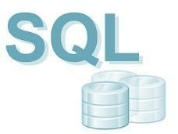
Introduction
In continuation of the above case, John wants to create tables, insert data and wants to fetch the records based on the requirements in his program. For this John finds SQL easy to use. He uses SQL to create the tables manually on the database client. He uses SQL Insert, update and delete to perform the operations on database data and SQL select statements to fetch the data from the database.

Slide 22
→ SQL Stands for Structured Query Language.
SQL
→ It is the language used in RDBMS to perform operations on DB.
→ It is easy to learn and understand.
→ User can perform create tables, insert, update, delete and select operations using SQL. When SQL command is fired on the database, database parser will parse the SQL command, understands it and performs the required operations.

Slide 23
SQL Commands
create table → To create a table.
insert into → To add the data in the table.
update → Update a record in the table. delete from → To delete records in the table. drop table → To delete a table.
alter table → To modify the table structure. A field can be added or deleted in the table. select → Used to display records from the table.
views → View of the db/table can be created.
avg(), count(), min(), max() are some of the functions of SQL.

Slide 24
SQL Datatypes
Data type | SQLServer | Oracle | MySQL
boolean | Bit | Byte | N/A
integer | Int | Number | Int Integer
float | Float Real | Number | Float
currency | Money | N/A | N/A
string (fixed) | Char | Char | Char
string (variable) | Varchar | Varchar Varchar2 | Varchar
binary object | Binary (fixed up to 8K) Varbinary (<8K) Image (<2GB) | Long Raw | Blob Text

Slide 25
SQL Commands
→ This command creates a table by name emp with 3 fields: id, name and dept
SQL> create table emp (id number, name varchar(20), dept varchar(20), address varchar(20), salary number);
→ This command will insert a record into emp table with values for the fields.
SQL> insert into emp values (120, ‘john','technology training', 'baltimore', 60000);
→ This command updates a record ' john' to ‘John snow' in emp table.
SQL> update emp set name=‘john snow' where name=‘john';
→ The following command removes a record where name is joe.
SQL> delete from emp where name=‘joe';

Slide 26
SQL Commands (contd.)
→ Drop TABLE removes the table from the database:
SQL > drop table emp;
→ To remove all the records of the table:
SQL> TRUNCATE TABLE emp;
→ Following command will adda field address to the emp table:
SQL> alter table emp add address varchar(20);
→ Following command displays all the records from emp table:
SQL>Select * from emp;

Slide 27
SQL SELECT Command
Select * from emp where name=‘John'; Select * from emp where salary > 50000; Select * from emp order by name;
Select * from emp order by name desc;
Select * from emp where salary between 10000 to 20000;
Select * from emp where Address IN (‘cal', ‘Arizona');

Slide 28
SQL Functions
→ Following SQL will display average, minimum and maximum salary.
SQL> select avg(salary), min(salary), max(salary) from emp;
→ Following command display number of records in the table emp using count(*)
SQL> select count(*) from emp;

Slide 29
JDBC

Slide 30
Introduction
In continuation of the above case, John wants to develop/generate reports from Java program. Instead of writing his own program for database operations, he uses JDBC and fetches the records and displays the data in the required format.
JDBC

Slide 31
JDBC
→ JDBC Stands for Java database connectivity.
→ JDBC API is the industry standard for database-independent connectivity.
→ JDBC interface is not specific to a database.
→ JDBC is a Java Library which is used to connect a database.

Slide 32
Features of JDBC
→ Obtains the connection with the database.
→ Connection usage: Every time for every database operation, a new connection need not be obtained. Once a connection is obtained with the database, this connection can be used for many database operations and towards the database connection can be closed.
→ Supports BLOB (Binary Large Object) and CLOB (Character Large Object.): BLOB is used to store binary data like voice, image etc., CLOB is used for storing large character data. It can also store single byte character or multi byte character data which support different languages like French, German etc.,
→ Batch updates.

Slide 33



Connection using JDBC
Java Application
JDBC
TCP/IP
Database

Slide 34

JDBC Procedure
Load the JDBC Driver
Connect to the database
Create a statement
Execute SQL Statement
Close the connection

Slide 35
Software Required for JDBC
→ Oracle/MySQL installation.
→ JDBC driver provided by the database vendor (jar file).
→ Remember the User ID and password of the database while installing. We need it while
connecting database from JDBC.

Slide 36










Java – DB Connectivity
Application(Java)
JDBC API
Driver Manager
JDBC
Driver
JDBC
Driver
JDBC
Driver
Oracle
MySQL
SQL

Slide 37










Driver Types
There are 4 types of JDBC drivers.
JDBC Drivers
Type 1: JDBC –
ODBC bridge
Type 2: Native API
Type 3: Server
Type 4: Pure Java driver

Slide 38

Annie’s Question
What does ODBC stand for?

Slide 39
Annie’s Answer
Open database connectivity.

Slide 40
What is ODBC?
→ ODBC (Open Database Connectivity) is a standard programming language middleware API for accessing database management systems (DBMS).
→ The designers of ODBC aimed to make it independent of database and operating systems.
→ An application written using ODBC can be ported to other platforms, both on the client and server side, with few changes to the data access code.
Why use ODBC at all?
The ideal is "Pure Java": no native code, no platform dependent features. But you may need to begin your development effort right away, without waiting for your DBMS to offer a Java-only JDBC driver.
Partly native drivers, such as the JDBC - ODBC Bridge, lets you create programs that easily adapt to pure Java drivers as they become available.
Ref - http://docs.oracle.com/javase/7/docs/technotes/guides/jdbc/bridge.html

Slide 41







Type 1 - Driver
Client tier
Java Client
→ Type 1 driver is JDBC-ODBC bridge.
→ ODBC is a standard API which is used to connect to the database.
JDBC-ODBC
Bridge
→ For Type-1 driver, Java communicates with JDBC.
ODBC
Driver
→ JDBC communicates with ODBC and ODBC communicates with DB and vice-versa.
→ In the initial stages ODBC was only the option for JDBC, hence JDBC is used to communicate database through ODBC.
Data Source

Slide 42




Type 2 - Driver
Client tier
Java Client
→ In Type-2 driver, JDBC calls are converted to native API code which is given by the database vendor itself.
JDBC-Native Library
→ Native API calls could be written either in C or in C++.
→ JDBC is depending on Native API to communicate with Database.
Native library
→ Since Native API is given by the database vendor, if the database is changed then its corresponding Native API should be used.
Data Source

Slide 43










Type 3 - Driver
Client tier
Java Client
Middle tier
→ JDBC will communicate with a server using network sockets.
App1
App2
→ This server will convert the request given by JDBC into the commands which database understands and communicates with the db. Db will perform the required operation.
App Server
3-tier JDBC Driver
→ This is called as 3-tier approach as JDBC, Server and DB are involved in it for DB transaction.
Data Source

Slide 44

Type 4 - Driver
Client tier
Java Client
→ Type 4 is pure Java driver.
→ JDBC does not depend on any other software/hardware to communicate with database.
All Java
JDBC Driver
→ JDBC driver has to be provided by the database vendor.
Data Source

Slide 45


JDBC Connection String
RDBMS | JDBC driver name | URL format | RDBMS
MySQL | com.mysql.jdbc.Driver | jdbc:mysql://hostname/ databaseName | MySQL
ORACLE | oracle.jdbc.driver.OracleDriver | jdbc:oracle:thin:@hostnam e:port Number:databaseName | ORACLE
DB2 | COM.ibm.db2.jdbc.net.DB2Driver | jdbc:db2:hostname:port Number/databaseName | DB2
Creating Connection for Mysql Database:
Host Name: localhost Database Name: edu Username: edureka Password: edureka

Slide 46

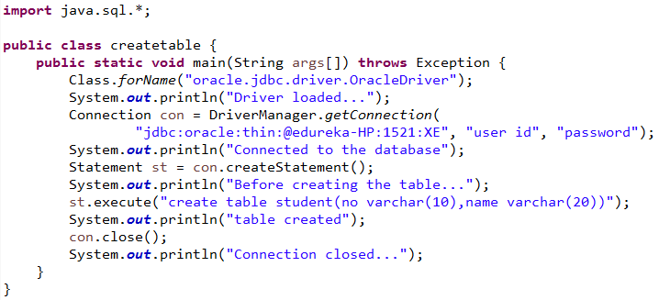
Program to Create Table in the db through JDBC

Slide 47
Program to Create Table in db through JDBC (contd.)
Class.forName loads the JDBC driver into memory.
Class Connection → The Connection class represents a connection with a specific database Interface Statement → The object used for executing a static SQL statement and returning the results it produces.
DriverManager.getConnection() → Connects with the database.
createStatement() → Creates a statement to store the SQL Query. execute() method executes the SQL in the statement in database.
close() method is used to close the connection.
This program will create student table in the database with 2 fields no and name as characters.

Slide 48

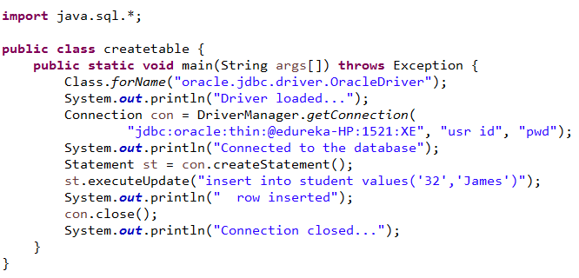
Program to Insert Data in db

Slide 49

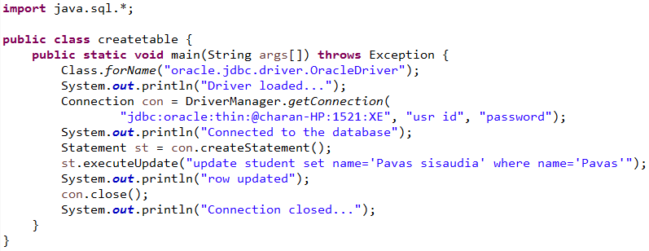
Program to Update a Record in db
This program will update a record if the name is Pavas to Pavas sisaudia in the student table.

Slide 50

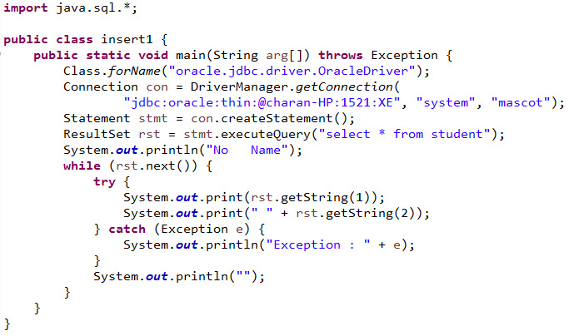
To Display Records using Select

Slide 51
To Display Records using Select (contd.)
When SQL Select query is given to the database, there is a possibility that database returns
multiple records. These records are stored in ResultSet Object.
ResultSet is like a pointer for the result obtained from the Select query.
ResultSet object will be pointing to before the first record initially. When next() is called in the loop, recordset pointer moves to the first record. Every time next() is called cursor moves to the next record. record.
getString(column number) → Returns the data of the column given by the column number in the record pointed by resultset.

Slide 52

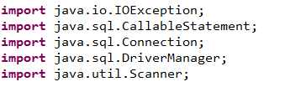
Calling Stored Procedures - Imports
Creating a Stored Procedure:
Create a stored procedure in MySQL with the below given code:
CREATE PROCEDURE insertIntoEMP(IN name1 VARCHAR(50), IN sal1 INT) BEGIN
insert into emp values (name1, sal1);
END
Imports Required:

Slide 53

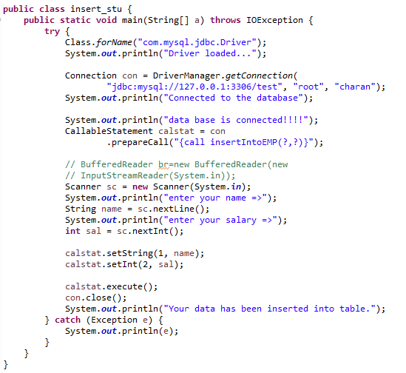
Calling Stored Procedures - Example

Slide 54
Calling Stored Procedures – Methods Used
In a JDBC program:
→ prepareCall() method is used to specify which stored procedure is to be executed.
→ Parameters can be filled in at runtime as using set() methods.
→ prepareCall() will return CallableStatement object to invoke stored procedures.
→ With execute() of CallableStatement object, stored procedure is executed.

Slide 55
JDBC - Exceptions
→ JDBC returns SQLException.
→ Object of SQLException in the catch block can be printed to see the exception.
→ This exception has getErrorCode() method which retrieves the vendor-specific exception code for this SQLException object.
Few basic methods are:
Method | Description
getErrorCode( ) | Gets the error number for the exception.
getMessage( ) | Gets the JDBC driver's error message for an error
printStackTrace( ) | Prints the current exception, or throwable, and its backtrace to a standard error stream.
printStackTrace(PrintStream s) | Prints this throwable and its backtrace to the print stream you specify.

Slide 56
Example - Batch Processing and Transaction Management
Transaction management: When multiple operations are performed on the database, if one or
more transaction fails then it is required to bring the database to the original state.
For example, if the bank wants to perform all the debit and credit transactions done on that day and if few transactions fail then it is not the correct state of the database data after performing the rest of the transactions. To maintain the correct state of the data, transaction management is required. By using Commit(), changes done in the db will be made permanent. By using RollBack() changes done in the db will be removed.
Batch Processing: When multiple sql queries are performed one after the other then JDBC will fire so many SQL commands. If 1000 queries need to be executed then 1000 times database is contacted for database operation. This will degrade the performance of the project.
To increase the performance, all the queries are placed in one batch and is transferred to the database as one batch and executed on the database.

Slide 57
Annie’s Question
Where do we need batch processing?

Slide 58
Annie’s Answer
We can save time if we put all the required statements as part of batch as it reduces the human intervention for every statement execution.

Slide 59

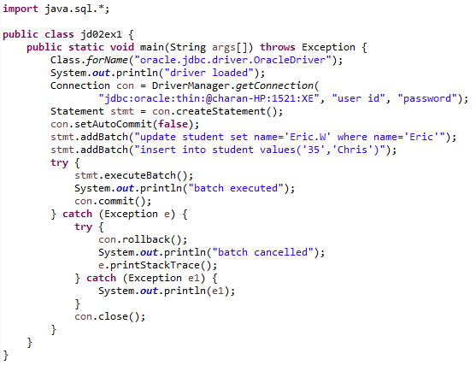
Program on Batch Processing and Transaction Management

Slide 60
Program on Batch Processing and Transaction Management (contd.)
catch(Exception e)
{
try{ con.rollback();
System.out.println("batch cancelled"); e.printStackTrace();
}
catch(Exception e1)
{
System.out.println(e1);
}
con.close();
} } }

Slide 61
Batch Processing and Transaction Management(contd.)
By using the method setAutoCommit(false), developer has to use commit() and rollback() manually
otherwise JDBC will take care.
AddBatch() is used to set of SQL commands of the batch.
ExecuteBatch() is used to execute the SQL statements in the batch.
If everything goes well then commit() is executed to make the transactions permanent.
If there is an exception then rollback() is executed to revert the changes done to the database
from this batch commands.

Slide 62

QUESTIONS

Slide 63

Assignment
Question Statement 1:
Write programs to create/insert/update/delete/select student table in the db. Student table will have the following fields:
→ Student ID
→ Name
→ Class
→ Marks
Question Statement 2:
Write a program to perform Batch processing and Transaction management for Student table created in Problem 1.

Slide 64

Agenda for the Next Class
In the next class, you will be able to:
→ Understand Client Server Architecture
→ Understand Server Types
→ Use Http and its methods
→ Understand servlet types and exceptions
→ Implement servlets
→ Understand and Implement Session Tracking
→ Use Filters

Slide 65

Pre-work
Read web technologies.

Slide 66
Survey
Your feedback is important to us, be it a compliment, a suggestion or a complaint. It helps us to make
the course better!
Please spare few minutes to take the survey after the webinar.

Slide 67



